Slide 1


Celebal Internship Project
Celebal Mentor – Mr. Tushar Mittal
Mentor – Dr. Kingshuk Srivastava

Slide 2
Topic
Configuration of Azure Data Factory and Create Pipelines to take Data from Azure Blob and Insert it into Azure SQL

Slide 3
Group Members
Member 1 –
Vibhav Sharma
500068472
B. Tech CSE - DevOps
Member 2 –
Siddhi Garg
500069229
B. Tech CSE - ECRA
Member 3 –
Shivam Chaudhary
500068546
B. Tech CSE OGI

Slide 4
Contents
Objective
Prerequisites
What’s New ?
Technologies Used
Project Demonstration
Conclusion

Slide 5
Objective
Creating a Data Factory pipeline that copies data from Azure Blob Storage to Azure SQL Database
Azure SQL Database is one of the most popular data repositories for hosting structured data on the Azure cloud.
Azure Data Factory on Azure cloud helps to transport and transform data from-and-to to a variety of data repositories.
The Copy Activity performs the data movement in Azure Data Factory. It is powered by a globally available service that can copy data between various data stores in a secure, reliable, and scalable way.

Slide 6
What’s New ?
Changes coming to Azure Pipelines free grants - By default, new organizations created in Azure DevOps may no longer get a free grant of concurrent pipelines. New users will have to send an email and provide additional information to get free CI/CD.
Azure Active Directory only authentication for Azure SQL - Public Preview for Azure Active Directory only authentication on Azure SQL Managed Instance.
Long term backup retention for Azure Managed Instance - Support for Long-term backup retention up to 10 years on Azure SQL Managed Instance.
Secret token will be a mandatory field when configuring provisioning - The secret token field could be kept empty when setting up provisioning on the custom / BYOA application. This function was intended to solely be used for testing. We'll update the UI to make the field required.

Slide 7
Prerequisites
Azure Account
Azure Storage account
Azure SQL Database
Azure Active Directory application

Slide 8
Technologies Used -

Slide 9
Azure Data Factory
Azure Data Factory is defined as a cloud-based ETL and data integration service.
The aim of Azure Data Factory is to fetch data from one or more data sources and load them into a format that we process.
The data sources might contain noise that we need to filter out. Azure Data Factory enables us to pull the interesting data and remove the rest.
Azure Data Factory to ingest data and load the data from a variety of sources into a variety of destinations i.e. Azure data lake.
It can create data-driven pipelines for orchestrating data movement and transforming data at scale.

Slide 10
Azure Blob Storage
Azure Blob storage is Microsoft’s Azure object storage solution for the cloud. It is designed for optimized and storing massive amounts of unstructured data.
It is used for Streaming video and audio, writing to log files, and Storing data for backup and restore disaster recovery, and archiving.
Azure Blob storage offers three types of resources:
The storage account
A container in the storage account
A blob in a container
Objects in Azure Blob storage are accessible via the Azure PowerShell, Azure Storage REST API, Azure CLI, or an Azure Storage client library.

Slide 11
Azure SQL Database
It is a fully-managed platform as a service. Here the platform manages aspects such as database software upgrades, patching, backups, the monitoring.
Using Azure SQL Database, we can provide a highly available and performant storage layer for our applications.
Types of Deployment Options for the SQL Database:
Single Database
Elastics Pool
Managed Instance
Azure SQL Database offers three service tiers:
General Purpose or Standard
Business Purpose or Premium
Hyperscale

Slide 12
Demonstration -

Slide 13
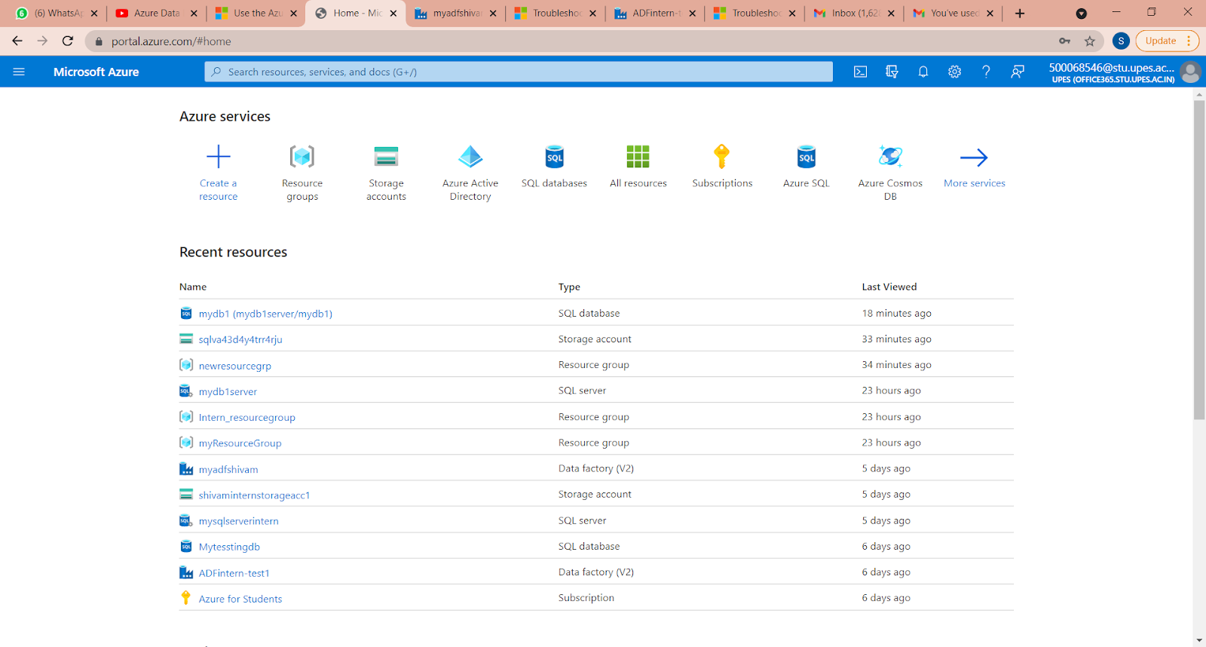
Opening the Azure Platform

Slide 14
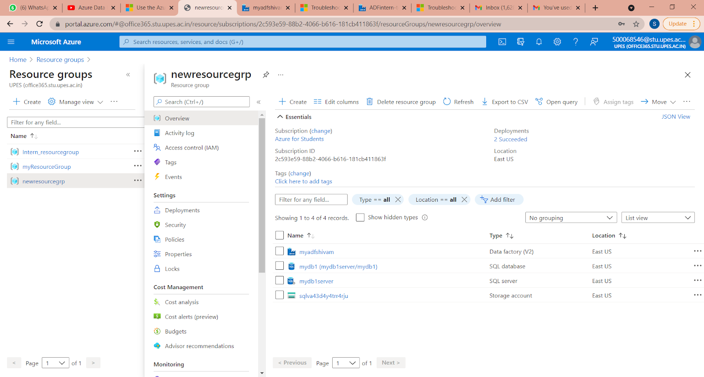
Creating the Resource Group

Slide 15
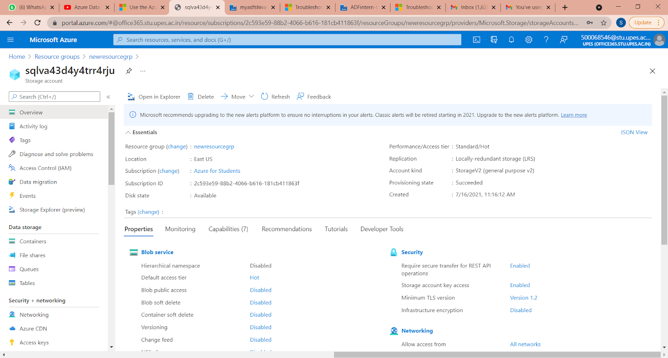
Storage Account

Slide 16
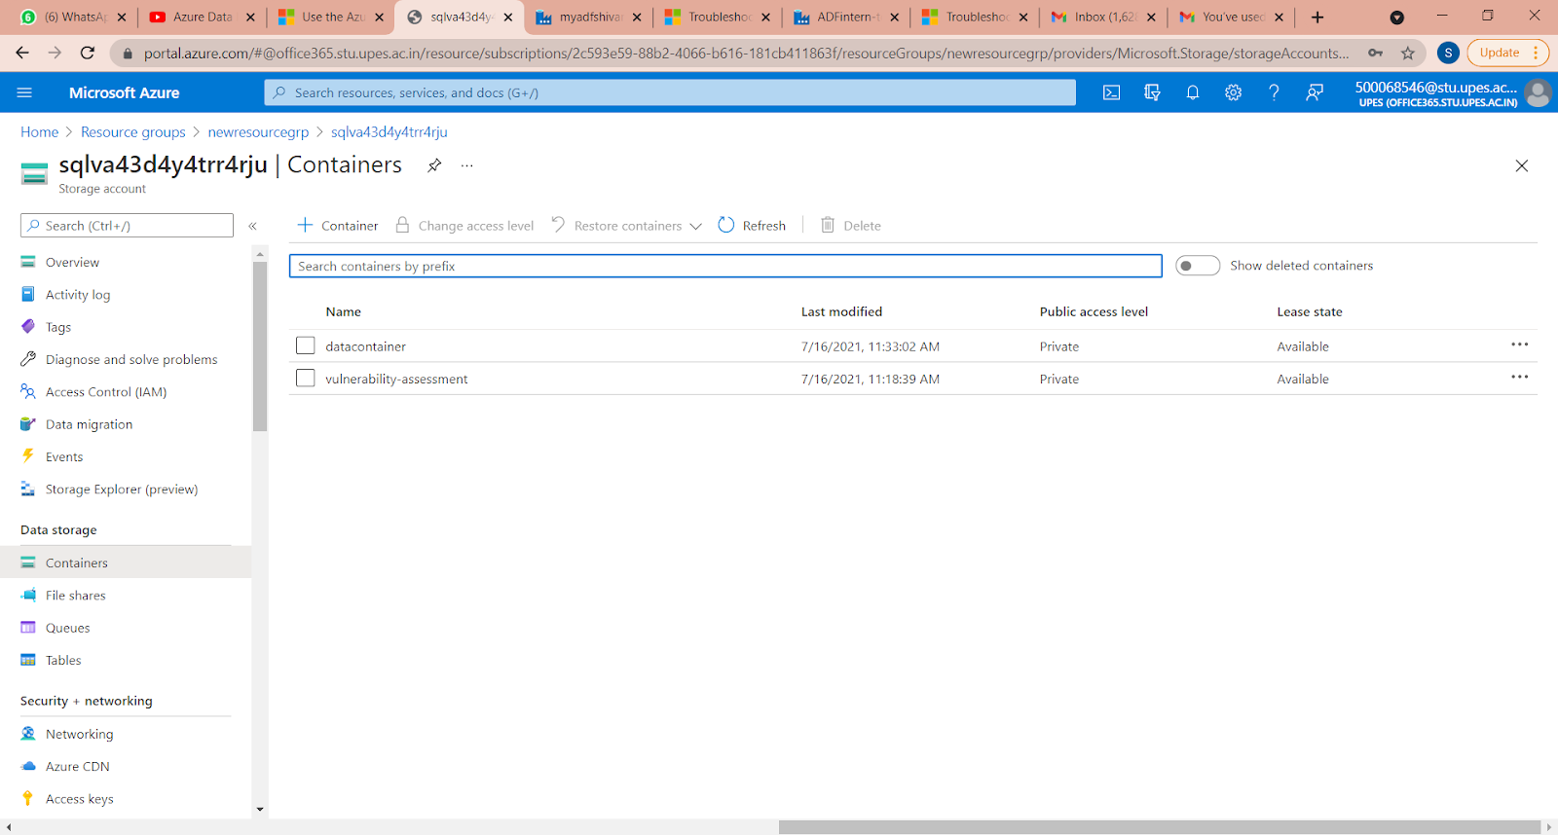
Containers in the Storage Account

Slide 17
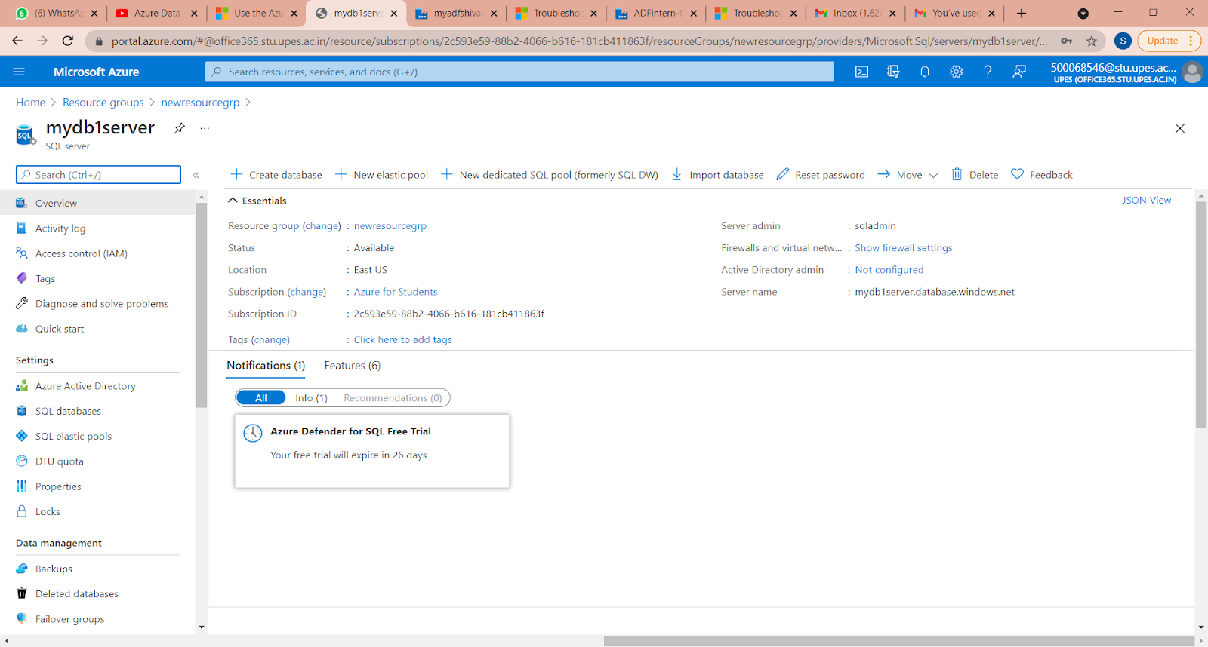
SQL Database Server

Slide 18
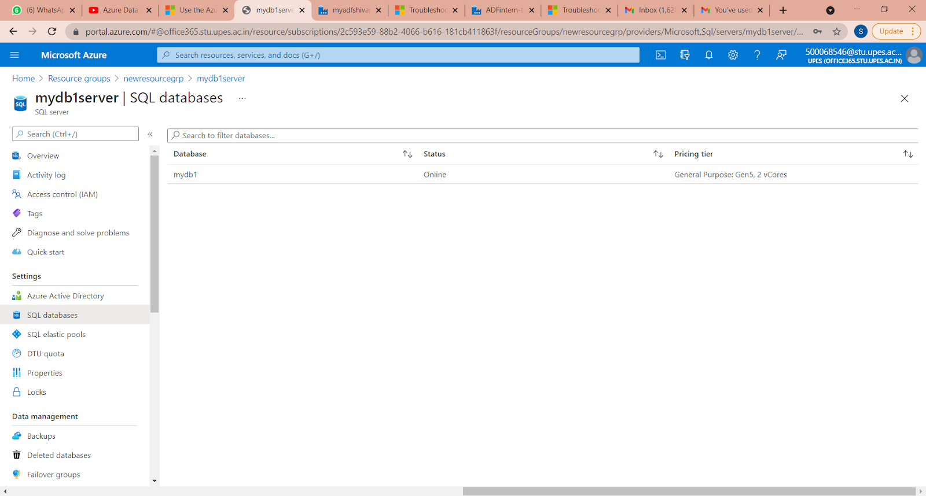
Upload Database in the Server

Slide 19
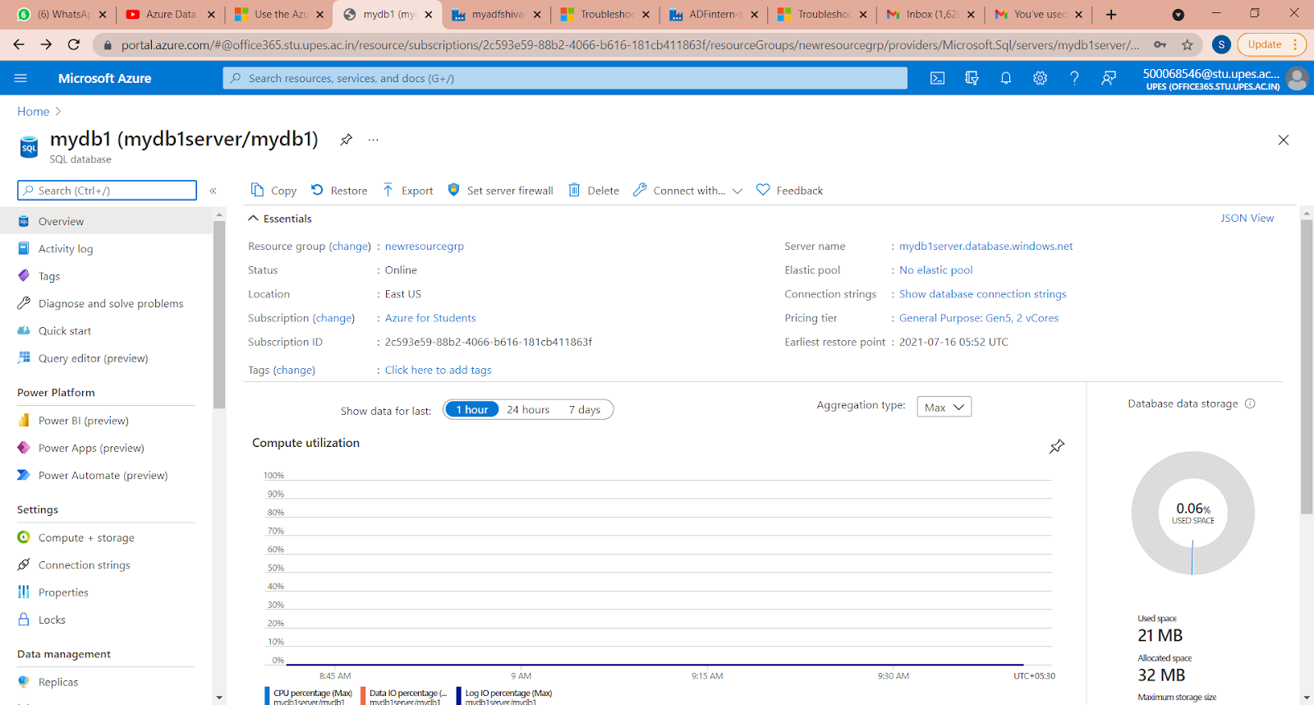

Slide 20
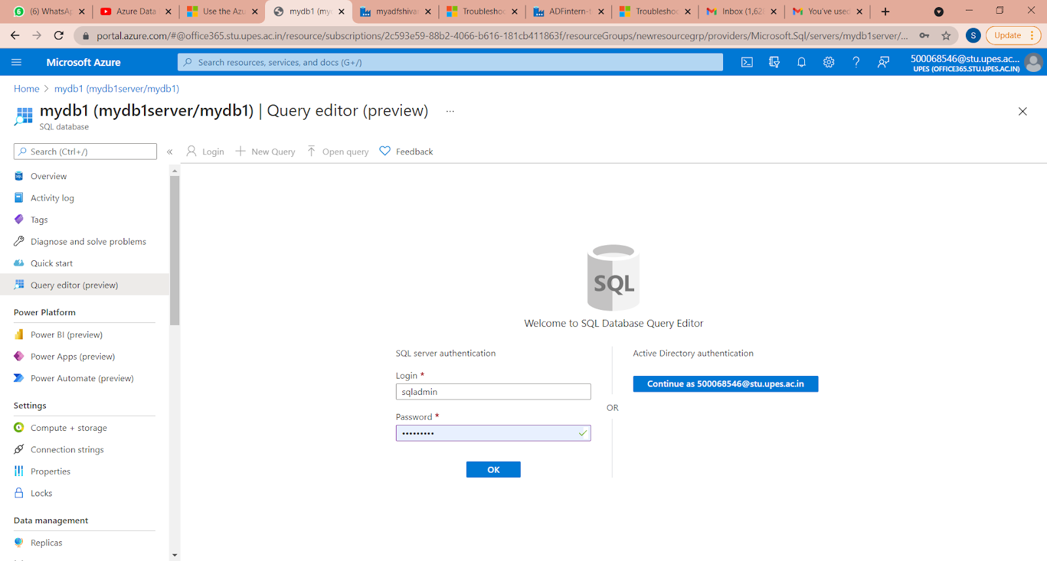
Opening the SQL Database Query Editor

Slide 21
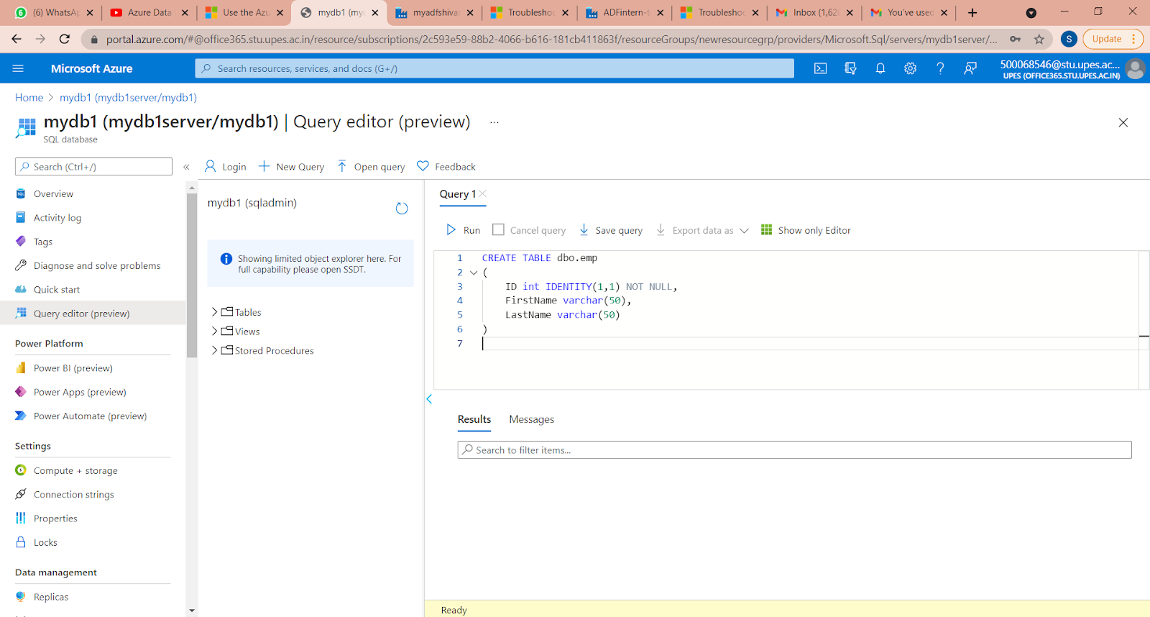
Query Used

Slide 22
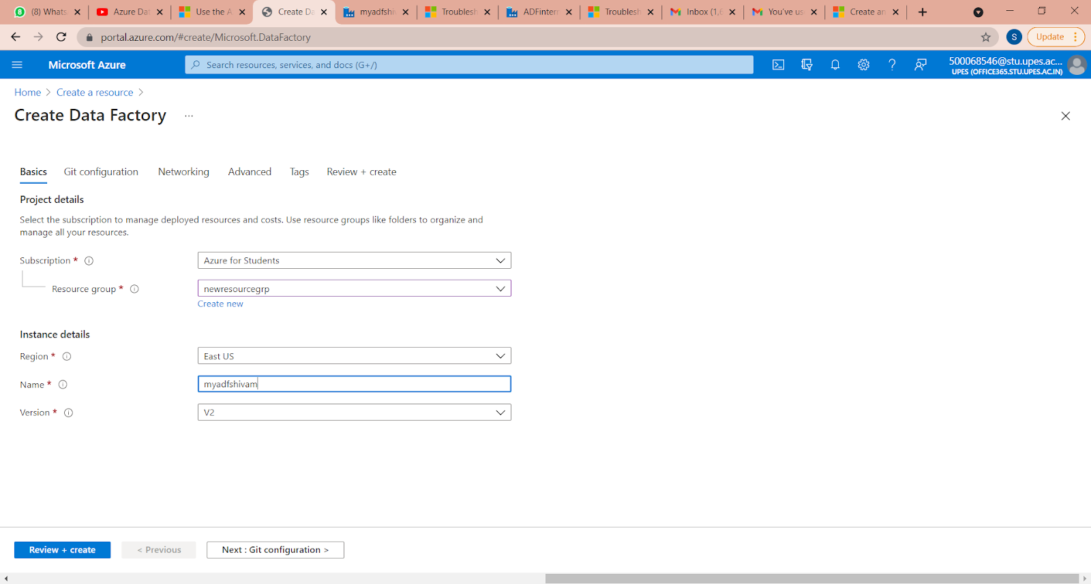
Creating Data Factory

Slide 23
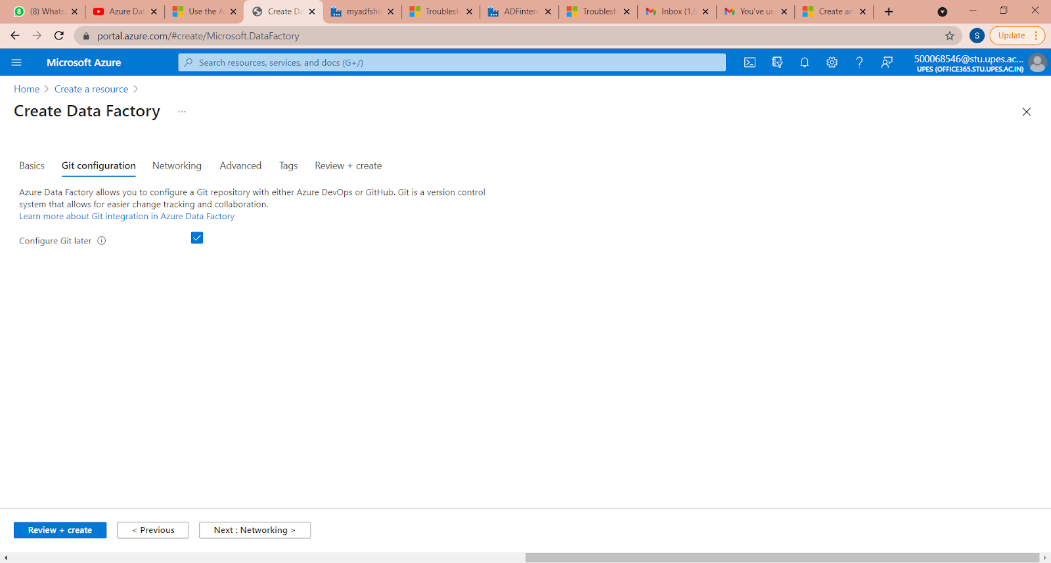

Slide 24
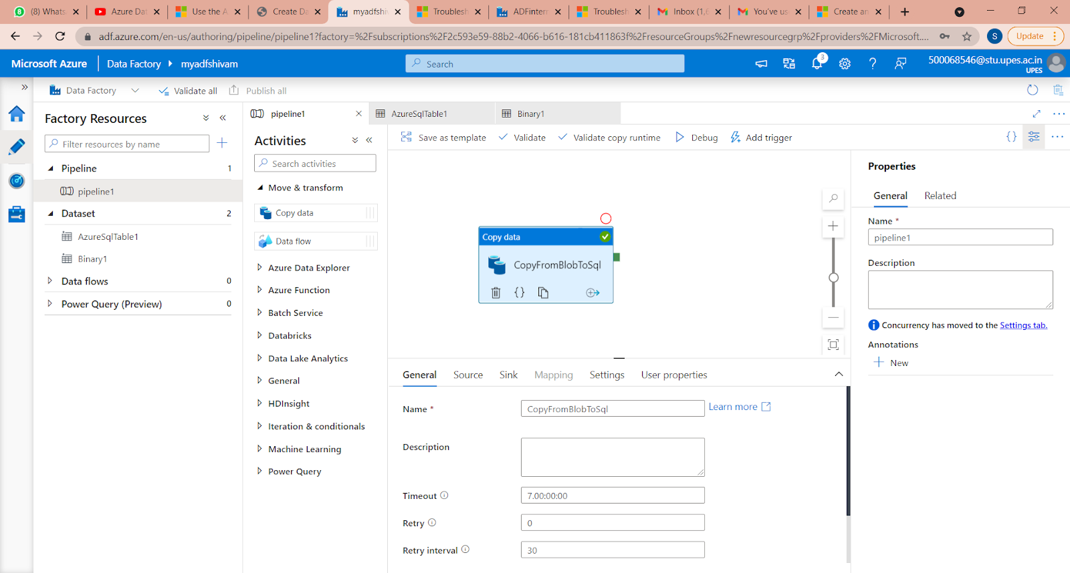
On the home page, select Orchestrate.
In the General panel under Properties, specify CopyPipeline for Name.
Then collapse the panel by clicking the Properties icon in the top-right corner.
In the Activities tool box expand the Move and Transform category, and drag and drop the Copy Data activity from the tool box to the pipeline designer surface.
Specify CopyFromBlobToSql for Name

Slide 25
Go to the Sink tab, and select + New to create a sink dataset.
In the New Dataset dialog box, input "SQL" in the search box to filter the connectors, select Azure SQL Database, and then select Continue. In this tutorial, you copy data to a SQL database.
In the Set Properties dialog box, enter Output Sq l Dataset for Name. From the Linked service dropdown list, select + New. A dataset must be associated with a linked service. The linked service has the connection string that Data Factory uses to connect to SQL Database at runtime. The dataset specifies the container, folder, and the file (optional) to which the data is copied.
In the New Linked Service Azure SQL Database) dialog box take the following steps:
Under Name, enter AzureSq lDatabaseLinkedService.
Under Server name, select your SQL Server instance.
Under Database name, select your database.
Under User name, enter the name of the user.
Under Password, enter the password for the user.
Select Test connection to test the connection.
Select Create to deploy the linked service.

Slide 26
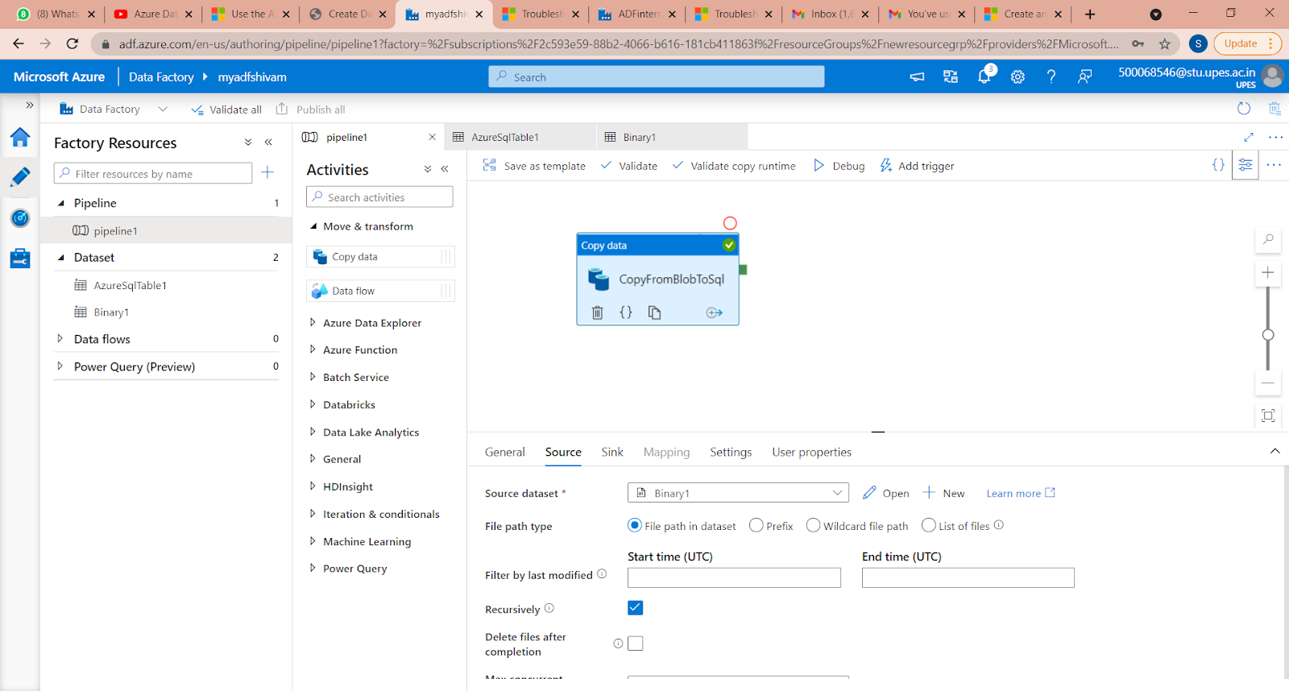

Slide 27
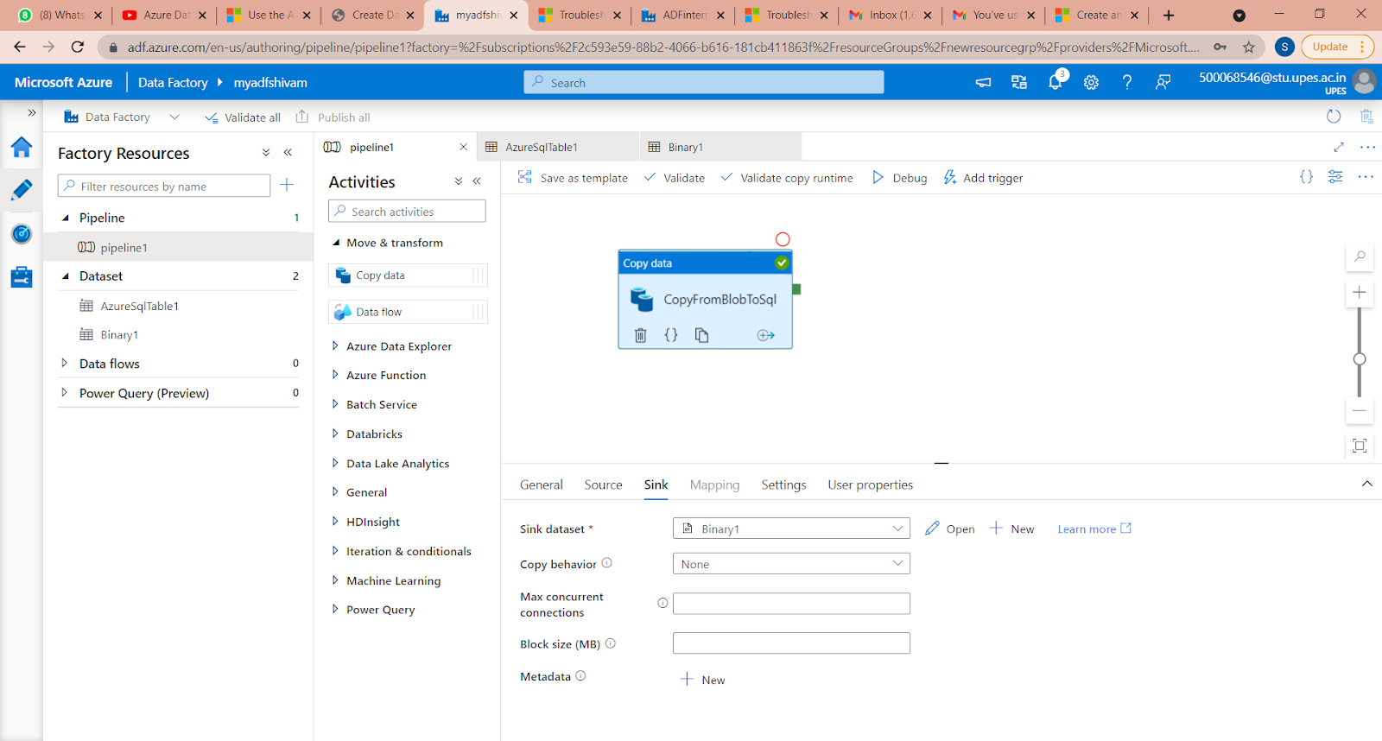
To debug the pipeline, select Debug on the toolbar. User see the status of the pipeline run in the Output tab at the bottom of the window.
Once the pipeline can run successfully, in the top toolbar, select Publish all. This action publishes entities (datasets, and pipelines) you created to Data Factory.
Wait until you see the Successfully Published message. To see notification messages, click the Show Notifications on the top-right

Slide 28
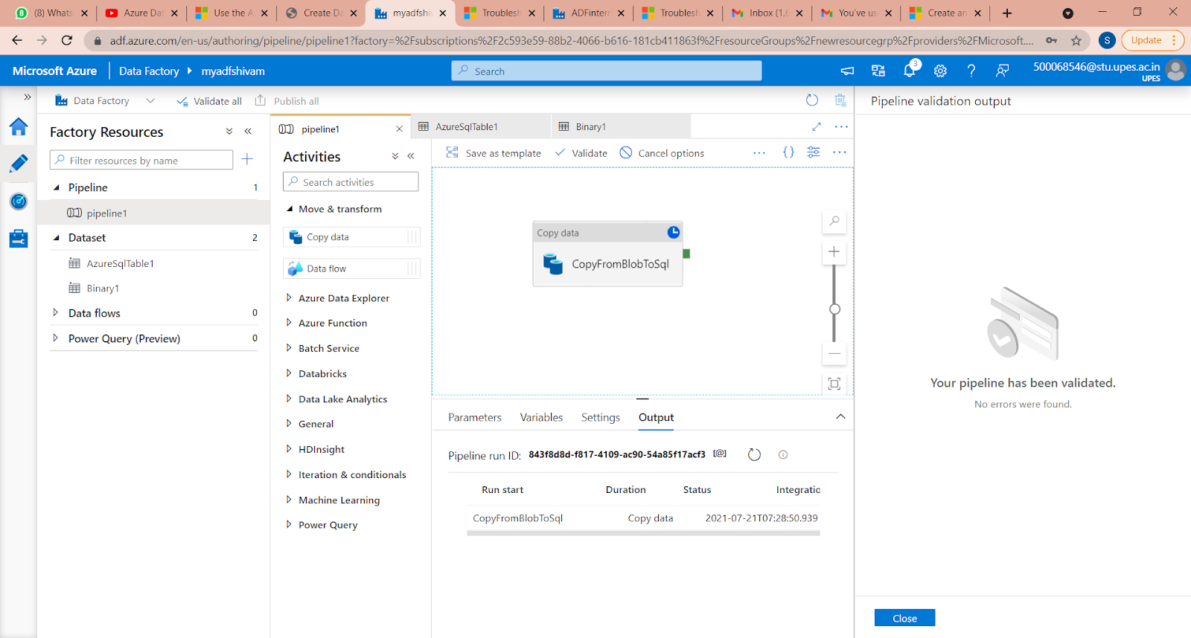
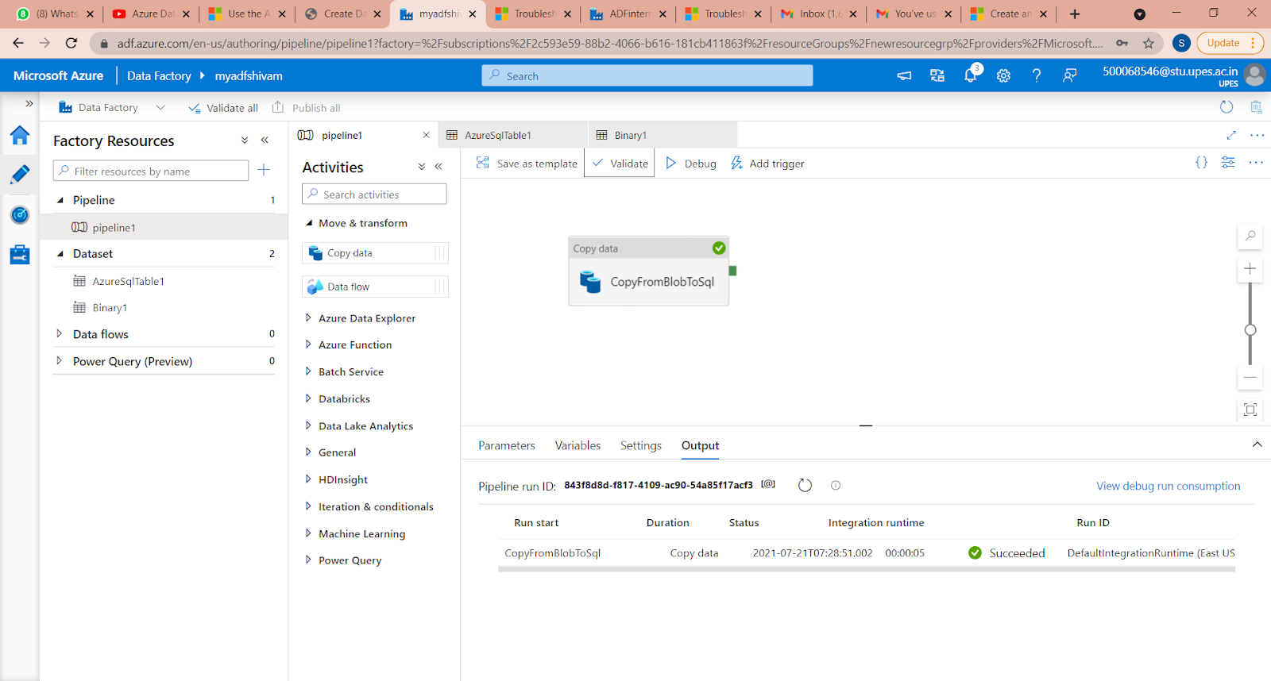

Slide 29
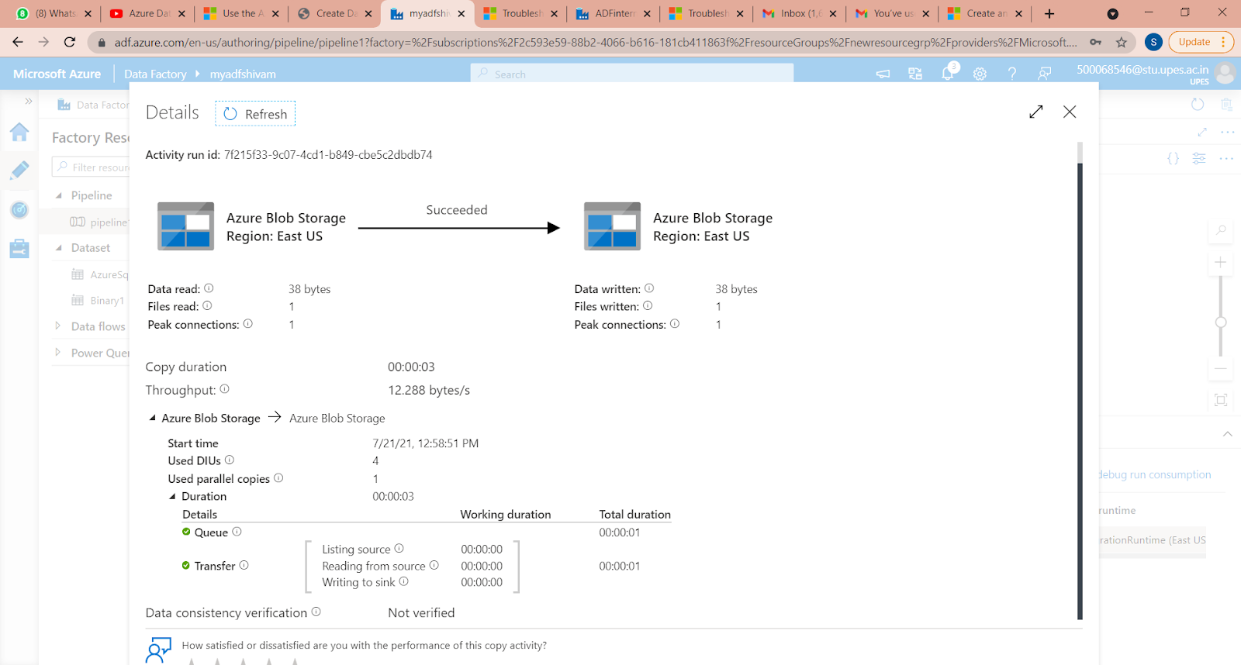
Transfer Completed

Slide 30
Conclusion
The setup of Azure blob storage and Azure SQL Database as the source and destination.
We used Azure Data Factory as the integrator to source data from a CSV file hosted in a container on Azure blob storage, configured and created the data pipeline, and populated this data in Azure SQL Database as the destination for this pipeline.
Used the different artifacts of Azure Data Factory like Linked Services, Pipelines, Azure Data Factory instance and configuration settings.

Slide 31


